Slide 1
Organizational Behaviour
Topic : Personality
C.Vijaya Banu, Ph.D
Professor
School of Management
SASTRA Deemed University
Thanjavur

Slide 2

Personality

Slide 3
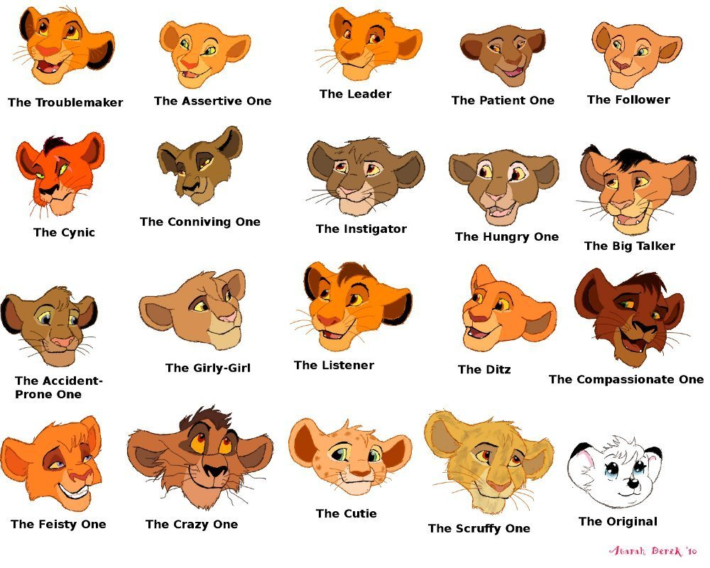
Personality

Slide 4
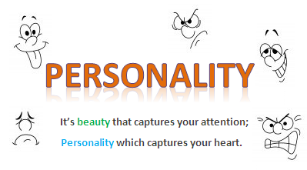
Personality

Slide 5
Personality
The combination of characteristics or qualities that form an individual's distinctive character.
The word personality is derived from a Greek word “persona” which means “to speak through”. Personality is the combination of characteristics or qualities that forms a person's unique identity. It signifies the role which a person plays in public.
“Personality is a pattern of relatively permanent traits and unique characteristics that give both consistency and individuality to a person’s behavior.”
“Personality represents those structural and dynamic properties of an individual or individuals as they reflect themselves in characteristic responses to situations”.

Slide 6
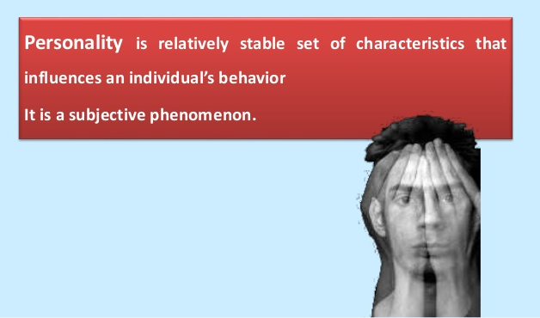

Slide 7
Characteristics of Personality
i) Personality is not related to bodily structure alone. It includes both structure and dynamics
(ii) Personality is an indivisible unit.
(iii) Personality is neither good nor bad.
(iv) Personality is not a mysterious phenomenon.
(v) Every personality is unique.
(vi) Personality refers to persistent qualities of the individual. It expresses consistency and regularly.
(vii) Personality is acquired.
(viii) Personality is influenced by social interaction.

Slide 8
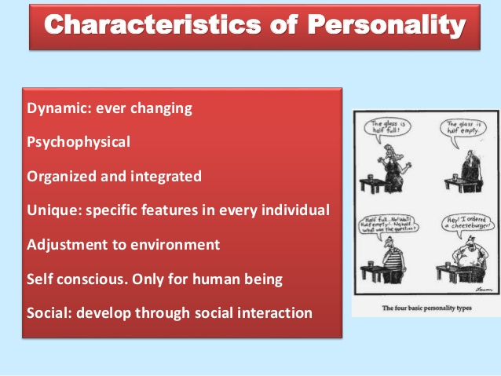

Slide 9
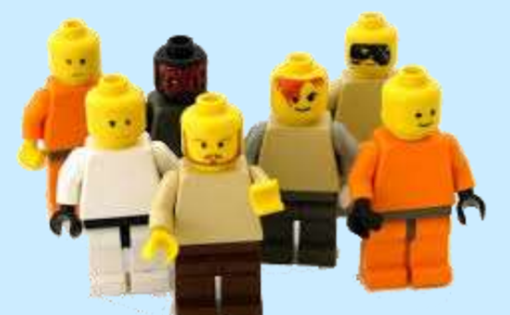
3 Facts to Consider When Defining “Personality”
Individuals are unique/different
Individuals behave differently in different situations
Although individuals are unique and behave inconsistently across situations, there is considerable commonality in human behavior

Slide 10
Personality: Some Important Terms
Personality: a person’s internally based characteristic way of acting and thinking
Character: Personal characteristics that have been judged or evaluated
Temperament: Hereditary aspects of personality, including sensitivity, moods, irritability, and distractibility
Personality Trait: Stable qualities that a person shows in most situations
Personality Type: People who have several traits in common

Slide 11
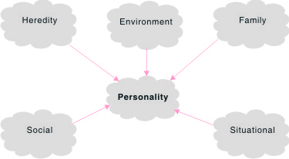
Determinants of Personality

Slide 12
Heredity and biological factors
Physique - Intelligence - Gender différences - Nervous system –
Emotional reactions
Aspiration - Aptitudes and attitude - Interest - Motivation - Intellectual level
Environmental factors
Family - Geography - Life pattern - Childhood experience - Neighbourhood - Friends - School - Media - Culture

Slide 13
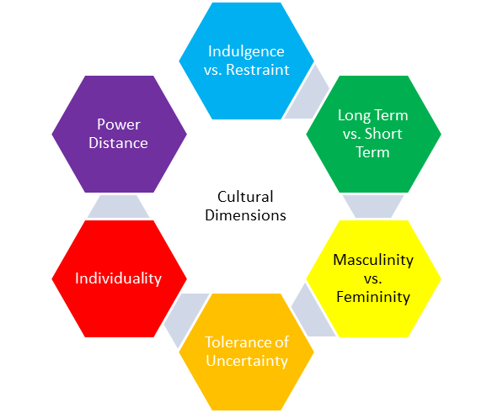
Different Culture-Hofstede's cultural dimensions

Slide 14
Determinants of Personality
Environmental Factors.
Physical Factors.
Situational Factors.
Hereditary.
Family and Social Factors.
Cultural Factors.

Slide 15
https://youtu.be/NmeUXSB_pwo
DOPE personality type

Slide 16
Theories of Personality
Trait Theories
Psychoanalytic Theory
Social-Cognitive Theories
Humanistic Theories
Behavioral Personality Theory
https://youtu.be/NmeUXSB_pwo
DOPE personality type

Slide 17
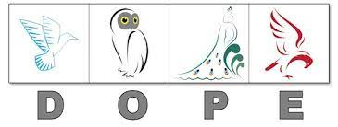

Slide 18
Types of Personality Theories
Trait Theories :Attempt to learn what traits make up personality and how they relate to actual behavior
Psychodynamic Theories: Focus on the inner workings of personality, especially internal conflicts and struggles
Humanistic Theories: Focus on private, subjective experience and personal growth
Social-Cognitive Theories: Attribute difference in personality to socialization, expectations, and mental processes

Slide 19
Trait Theory

Slide 20
Carl Jung theory (1875 -1961)
Jung’s Theory of Two Types Carl Jung, Swiss psychiatrist who was a Freudian disciple, believed that we are one of two personality types:
• Introvert: Shy, self-centered person whose attention is focused inward
• Extrovert: Bold, outgoing person whose attention is directed outward

Slide 21
Eysenck Theory 1916-1997
Eysenck’s Three Factor Theory Hans Eysenck, English psychologist, believed that there are three fundamental factors in personality:
• Introversion versus Extroversion
• Emotionally Stable versus Unstable (neurotic)
• Impulse Control versus Psychotic
Eysenck’s Theory, continued The first two factors create 4 combinations, related to the four basic temperaments recognized by ancient Greeks:
• Melancholic (introverted + unstable): sad, gloomy
• Choleric (extroverted + unstable): hot-tempered, irritable
• Phlegmatic (introverted + stable): sluggish, calm
• Sanguine (extroverted + stable): cheerful, hopeful

Slide 22
Cattell theory 1905-1998
Source & Surface Traits Raymond Cattell: from Devon, England, believed that there were two basic categories of traits:
• Surface Traits: Features that make up the visible areas of personality
• Source Traits: Underlying characteristics of a personality
The Big Five/Five Factor Model Cattell believed that five factors were most important: Openness ,Conscientiousness, Extraversion, Agreeableness ,Neuroticism (OCEAN)

Slide 23
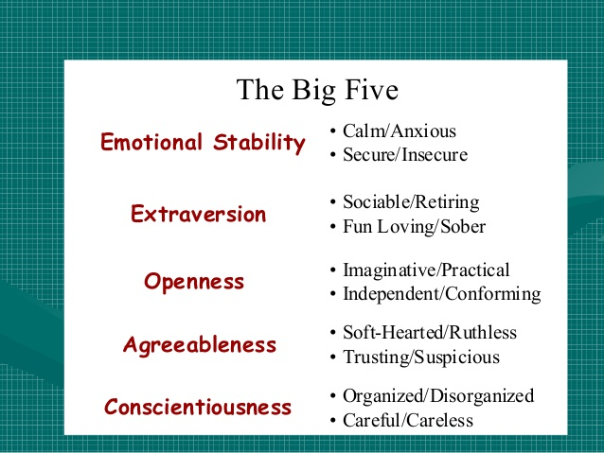

Slide 24
Big Five Personality Dimensions
Conscientiousness
Caring, dependable
Emotional Stability
Poised, secure
Openness to Experience
Sensitive, flexible
Agreeableness
Courteous, empathic
Extroversion
Outgoing, talkative

Slide 25
The Big Five Model of Personality Dimensions
Extroversion- reflects a person's comfort level with relationships Sociable, gregarious, talkative and assertive
Agreeableness- person's ability to get along with others Good-natured, courteous, caring, cooperative, and trusting.
Conscientiousness -number of goals that a person focuses on. Responsible, careful, dependable, persistent, and organized.
Emotional Stability (Neuroticism ) -focuses on an individual's ability to cope with stress Calm, self-confident, secure (positive) versus nervous, depressed, and insecure (negative), (hostile and anxious).
Openness to Experience- addresses one's range of interests. Extremely open people are fascinated by novelty and innovation. Imaginativeness, artistic, sensitivity, flexible and intellectualism.

Slide 26
Psychoanalytic Perspective of Personality SIGMUND FREUD

Slide 27
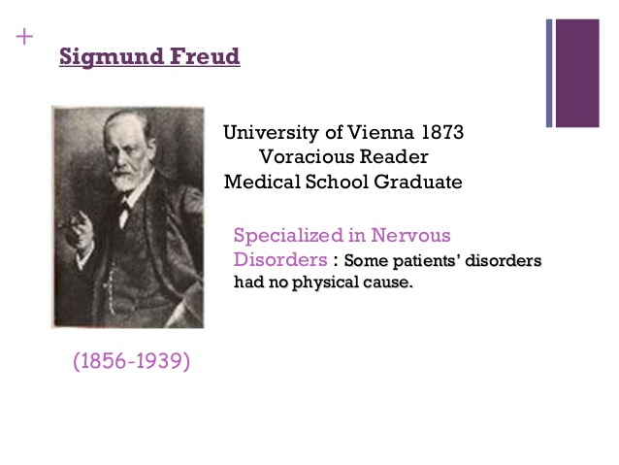

Slide 28
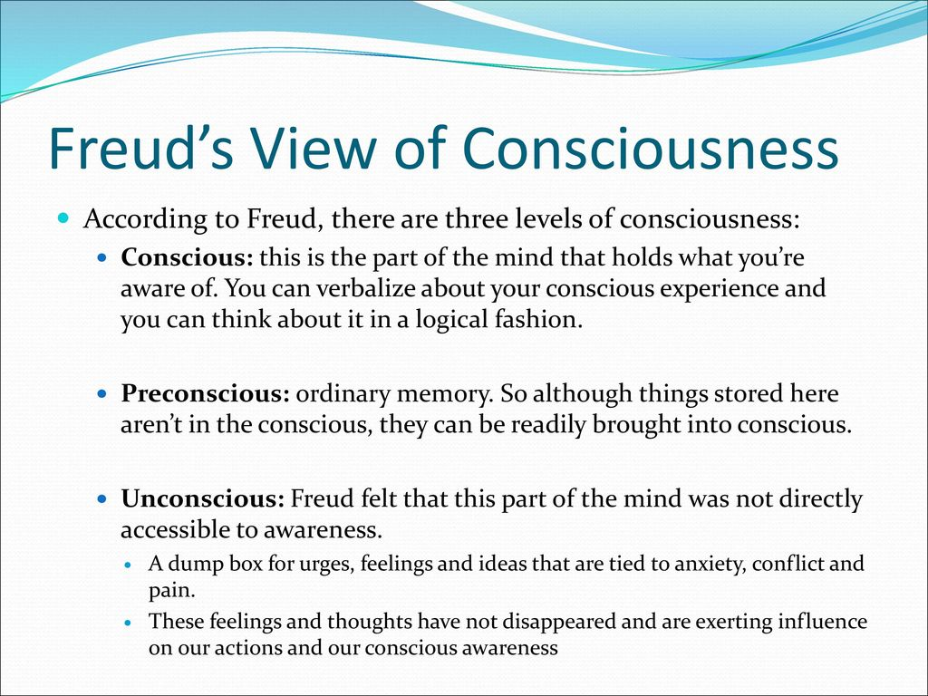

Slide 30
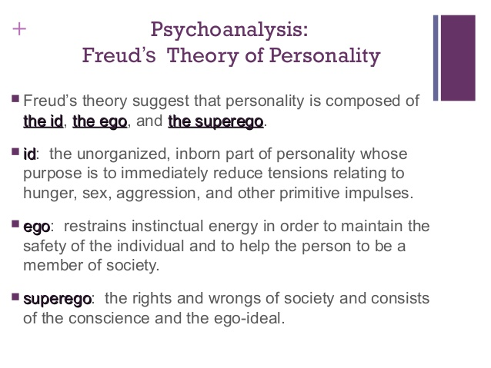

Slide 31
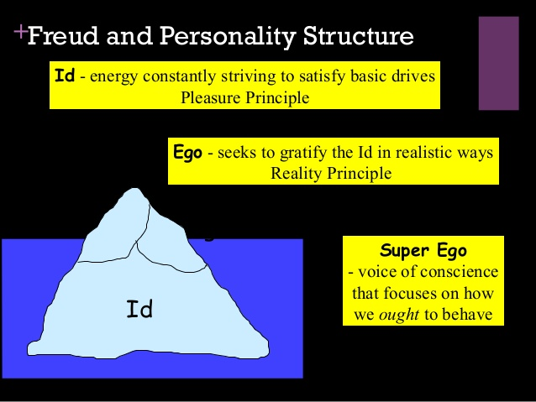

Slide 32
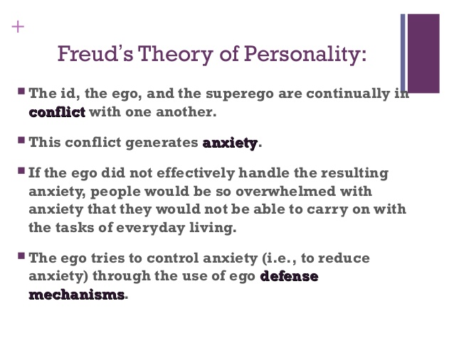

Slide 33
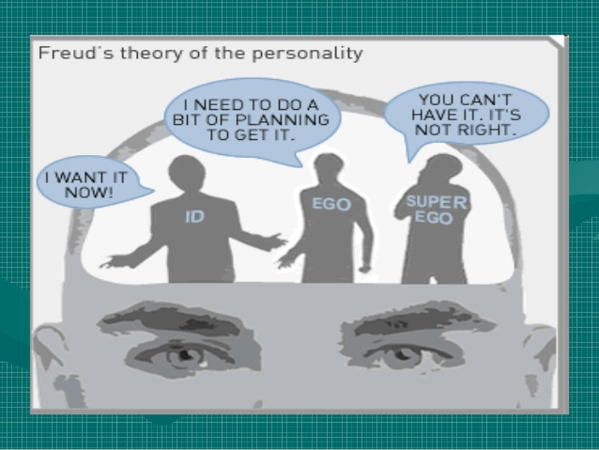

Slide 34
PSYCHOANALYTIC THEORY-
“PSYCHOANALYTIC THEORY”- Sigmund Freud- personality comprises id, ego and super ego
The id'is the mental agency containing everything inherited, present at birth, and fixed in the individual's constitution, especially instincts
The Ego -Mental images do not satisfy needs The ego develops out of the id.
Super ego judges whether an action is right or wrong according to the standards of society

Slide 35
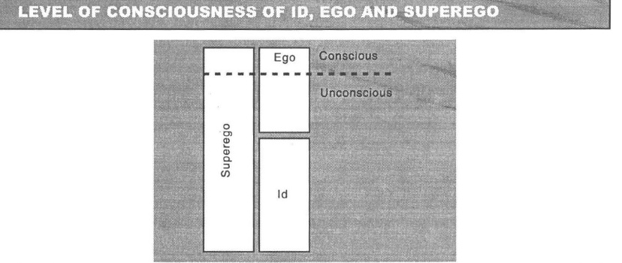
Sigmund Freud- personality

Slide 36
Defense Mechanisms
A defense mechanism is a tactic developed by the ego to protect against anxiety.
Defense mechanisms are thought to safeguard the mind against feelings and thoughts that are too difficult for the conscious mind to cope with.

Slide 37
Defense Mechanisms
• Repression The removal of threatening thoughts from awareness;
• Projection The attribution of unacceptable impulses to others;
• Denial The refusal to recognize a threatening situation or thought;
• Rationalization Giving a reasonable explanation for an event;
• Regression The return to a less mature, anxiety reducing behaviour;
• Reaction formation The expression of the opposite of disturbing ideas;
• Displacement Substituting a less threatening object for impulses;
• Sublimation The channeling of impulses to socially acceptable outlets

Slide 38
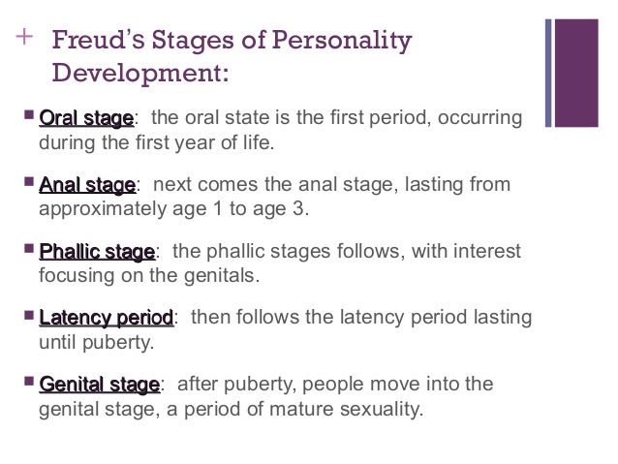

Slide 39
Social cognitive theories

Slide 40
Bandura’s Theory Self-system: the set of cognitive processes by which a person observes, evaluates, and regulates his/her behavior. Bandura proposed that what we think of as personality is a product of this self-system.
Rotter’s Theory of Locus of Control
Julian Rotter: American psychologist, began as a Freudian! His personality theory combines learning principles, modeling, cognition, and the effects of social relationships
External locus of control: perception that chance or external forces beyond personal control determine one’s fate
Internal locus of control: perception that you control your own fate. Learned Helplessness: a sense of hopelessness in which a person thinks that he/she is unable to prevent aversive events

Slide 41
Humanistic Theories

Slide 42
Humanistic Theories
Humanism: Approach that focuses on human experience, problems, potentials, and ideals
Human Nature: Traits, qualities, potentials, and behavior patterns most characteristic of humans
Free Choice: Ability to choose that is NOT controlled by genetics, learning, or unconscious forces
Subjective Experience: Private perceptions of reality
Maslow’s Theory • Abraham Maslow is considered father of the humanistic movement. He observed the lives of (purportedly) healthy and creative people to develop is theory.
Hierarchy of needs: the motivational component of Maslow’s theory, in which our innate needs, which motivate our actions, are hierarchically arranged. • Self-actualization: the fullest realization of a person’s potential

Slide 43
Behavioral Personality Theory

Slide 44
Behavioral Personality Theory
Behavioral Personality Theory Behavioral theories suggest that personality is a result of interaction between the individual and the environment. Behavioral theorists study observable and measurable behaviors, rejecting theories that take internal thoughts and feelings into account.

Slide 45
The Myers-Briggs Type Indicator
Myers-Briggs Type Indicator (MBTI) -During the 1920s, the Swiss psychologist Carl Jung proposed a personality theory. Twenty years later, the mother and daughter team of Katherine Briggs and Isable Briggs-Myers developed the Myers-Briggs Type Indicator (MBTI).A personality test that taps four characteristics and classifies people into 1 of 16 personality types.
Personality Types
Extroverted vs. Introverted (E or I)
Sensing vs. Intuitive (S or N)
Thinking vs. Feeling (T or F)
Judging vs. Perceiving (P or J)

Slide 46
Myers-Briggs Type Indicator
Used for employee hiring process, MBTI measures how people prefer to focus their
attention (extroversion versus introversion),
collect information (sensing versus intuition),
process and evaluate information (thinking versus feeling), and
orient themselves to the other world (judging versus perceiving).

Slide 47
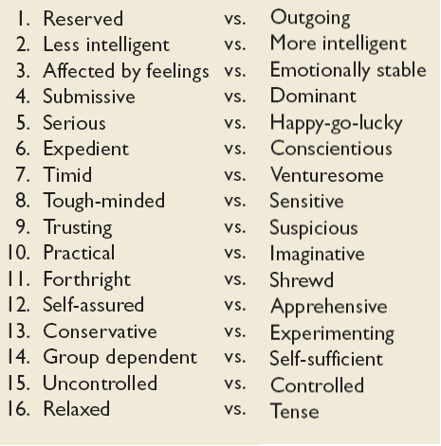
Myers-Briggs Sixteen Primary Traits

Slide 48
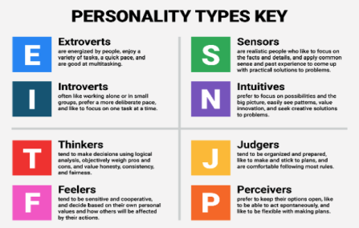
16 Personality types -Key

Slide 49
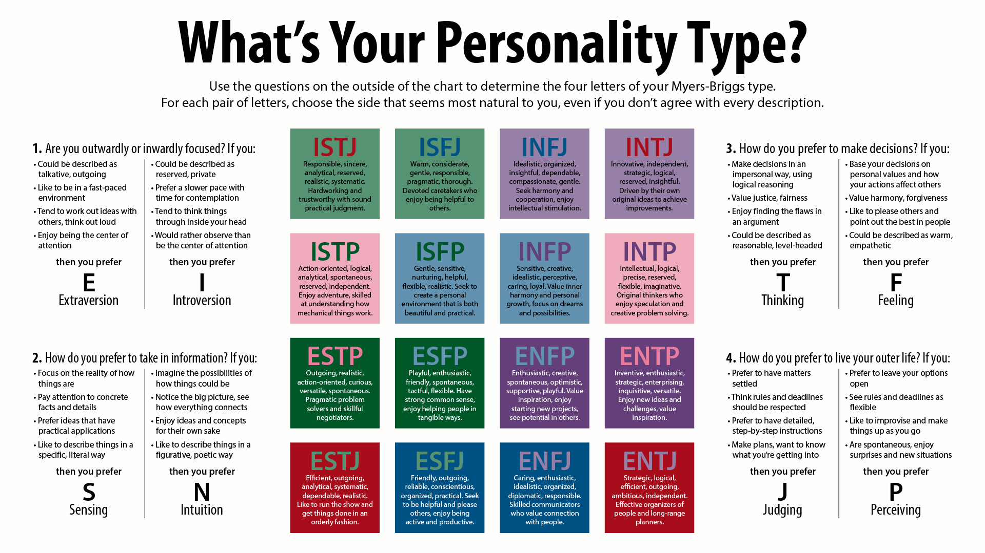
16 Personality types

Slide 50
Personality Types
Type A’s
are always moving, walking, and eating rapidly;
feel impatient with the rate at which most events take place;
strive to think or do two or more things at once;
cannot cope with leisure time;
are obsessed with numbers, measuring their success in terms of how many or how much of everything they acquire.
Type B’s
never suffer from a sense of time urgency with its accompanying impatience;
feel no need to display or discuss either their achievements or accomplishments;
play for fun and relaxation, rather than to exhibit their superiority at any cost;
can relax without guilt.

Slide 51
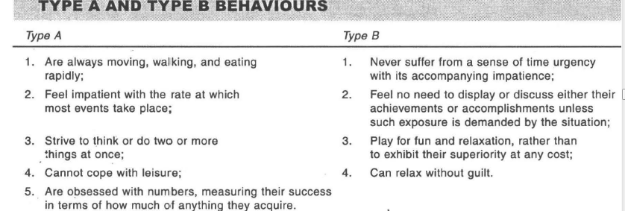
Type Personality

Slide 52
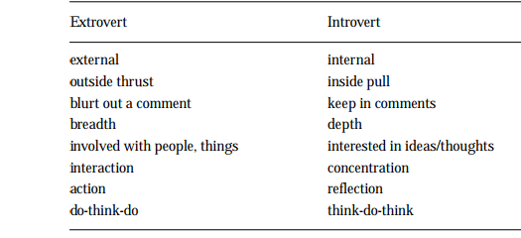
Differences

Slide 53
“Type” theory
individuals are categorized depending upon
their physical characteristics
short, plump person (endomorph) was said to be sociable, relaxed, and even tempered;
tall, thin person (endomorph) was characterized as restrained, self-conscious, and fond of solitude;
heavy-set muscular individual (mesomorph) was described as noisy, callous, and fond of physical activity
Introverts -shy, quiet, and retiring
Extroverts-gregarious, sociable individuals,

Slide 54
Personality Traits
Authoritarians also tend to be rigid in their positions, place high moral value on their beliefs, and are strongly oriented towards conformity to rules and regulations ,who prefer stable and structured work environments which are governed by clean rules and procedures.
Locus of control is how strongly people believe they have control over the situations and experiences belief ,events are either with in one's control (internal locus of control) or are determined by forces beyonj one's control (external
locus of control).
Machiavellianism refers to individual's propensity to manipulate people.
Self-esteem refers to the feeling of like or dislike of one-self
Risk-taking People differ in their willingness to take chances
Self Monitoring refers to an individual's ability to adjust his or her behaviour to external factors
Narcissistic personality disorder is a mental disorder in which people have an inflated sense of their own importance, a deep need for admiration and a lack of empathy for others

Slide 55

Major Personality Attributes Influencing OB
Core self-evaluation
Self-esteem – a person’s view of themselves
Locus of control – degree to which you believe you have control of your own fate
Machiavellianism – degree to which a person is pragmatic, maintains emotional distance and believes that the ends can justify the means, characterized by subtle or unscrupulous cunning, deception, expediency, or dishonesty
Narcissism – degree of sense of self-importance and arrogance; people have an inflated sense of their own importance, a deep need for excessive attention and admiration, troubled relationships, and a lack of empathy for others.

Slide 56
Component of Managerial Competencies
Managerial Effectiveness
Communication Competency
Planning and Administration Competency
Strategic Action Competency
Self-Management Competency
Global Awareness Competency
Teamwork Competency

Slide 57
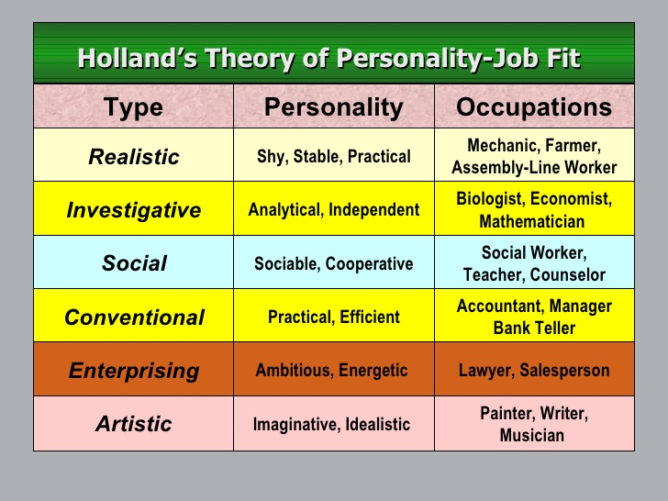
Holland Personality types

Slide 58
Achieving Person-Job Fit
Personality-Job Fit Theory (Holland)
Identifies six personality types and proposes that the fit between personality type and occupational environment determines satisfaction and turnover.
Personality Types
Realistic
Investigative
Social
Conventional
Enterprising
Artistic

Slide 59
http://peacebenwilliams.com/lets-play-what-is-your-true-personality
https://www.personalityperfect.com/test/free-personality-test/

